Slide 1
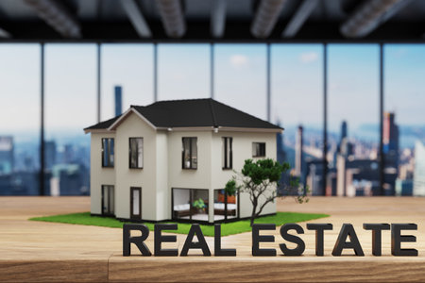
PROJECT OWNER
JULIE KUMARI
INSIGHTS

Slide 2
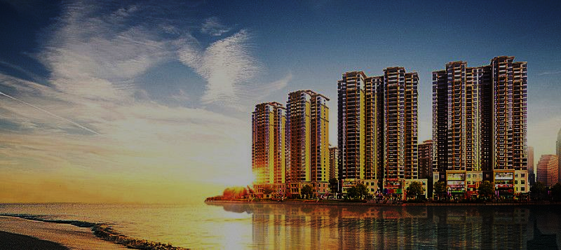
INTRODUCTION
KPI/ OBJECTIVES
INSIGHTS
CONCLUSION

Slide 3

INTRODUCTION
Delving into the intricacies of the flat market, from pricing nuances to location desires and feature preferences, unlocks a treasure trove of insights. Not only does it illuminate market trends and consumer desires, but it also provides a fertile ground for honing data analysis skills in a tangible, real-world context, paving the way for informed investment decisions.

Slide 4
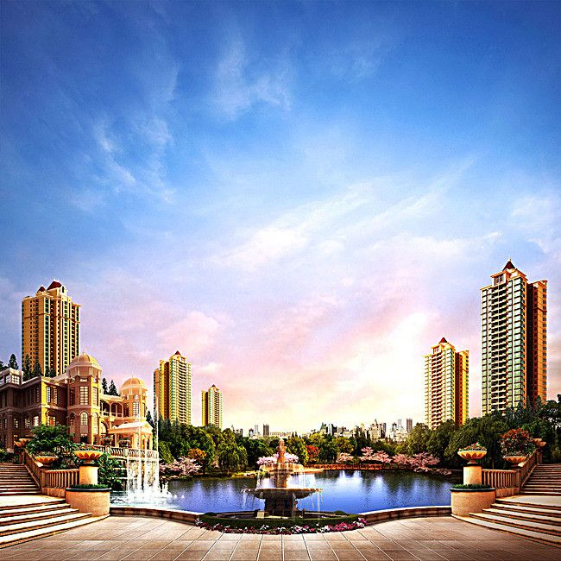
KPI/ OBJECTIVES
How many flats are listed in each society?
What is the average price of 2 BHK flats?
Count the number of flats available in each bedroom category.
What is the distribution of flats based on the number of bathrooms?
Determine the average area of flats for each type of facing (e.g., North, South)
Analyze the correlation between the area of flats and their prices.
Create a histogram to visualize the distribution of flat prices.
What is the most common number of floors in the listed houses?
Calculate the average price of houses with more than 3 bedrooms.
Compare the average areas of furnished vs. unfurnished houses.

Slide 5
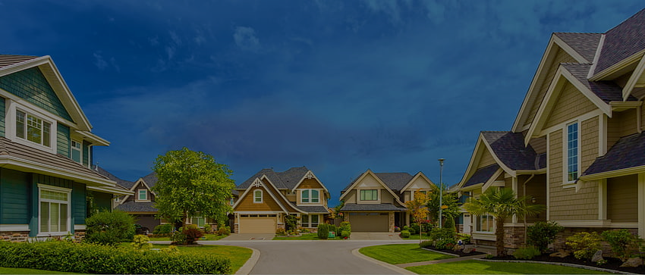
INSIGHTS
How many flats are listed in each society?
What is the average price of 2 BHK flats?

Slide 6

Count the number of flats available in each bedroom category.
What is the distribution of flats based on the number of bathrooms?

Slide 7

Determine the average area of flats for each type of facing (e.g., North, South
Analyze the correlation between the area of flats and their prices.

Slide 8

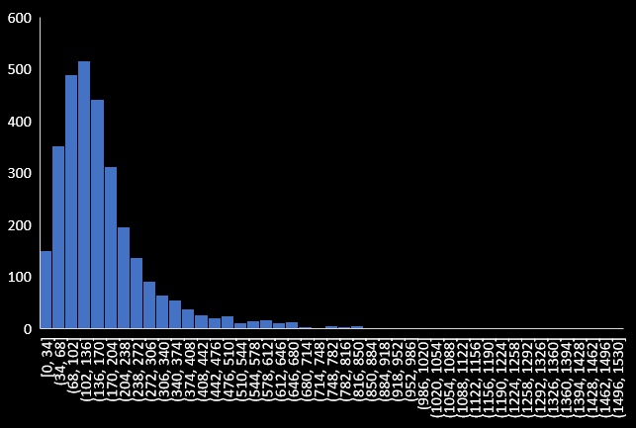
Create a histogram to visualize the distribution of flat prices.
What is the most common number of floors in the listed houses?
3rd Floor
is the most common number of floors

Slide 9

Calculate the average price of houses with more than 3 bedrooms.
Compare the average areas of furnished vs. unfurnished houses.

Slide 10

CONCLUSION
The Leaf 3.8 is a top society with a variety of flats available, with 2 BHK being the most common and having an average price of ₹88.6 lakhs. The society has more 2 and 3 bedroom flats than 1 and 4 bedroom flats, and very few 5 and 6 bedroom flats. There are more flats with 2 bathrooms than any other number. The correlation between the area of flats and their prices is very weak. The 3 most common number of floors in the listed houses are not mentioned. Flats with 16 bedrooms have the highest average price, while unfurnished flats have a much higher average area than furnished flats.

Slide 11






THANK YOU
_julie_03_
julie-kumari
juliekumari2014@gmail.com
https://peerlist.io/_julie_
PROJECT OWNER
JULIE KUMARI

